Slide 1
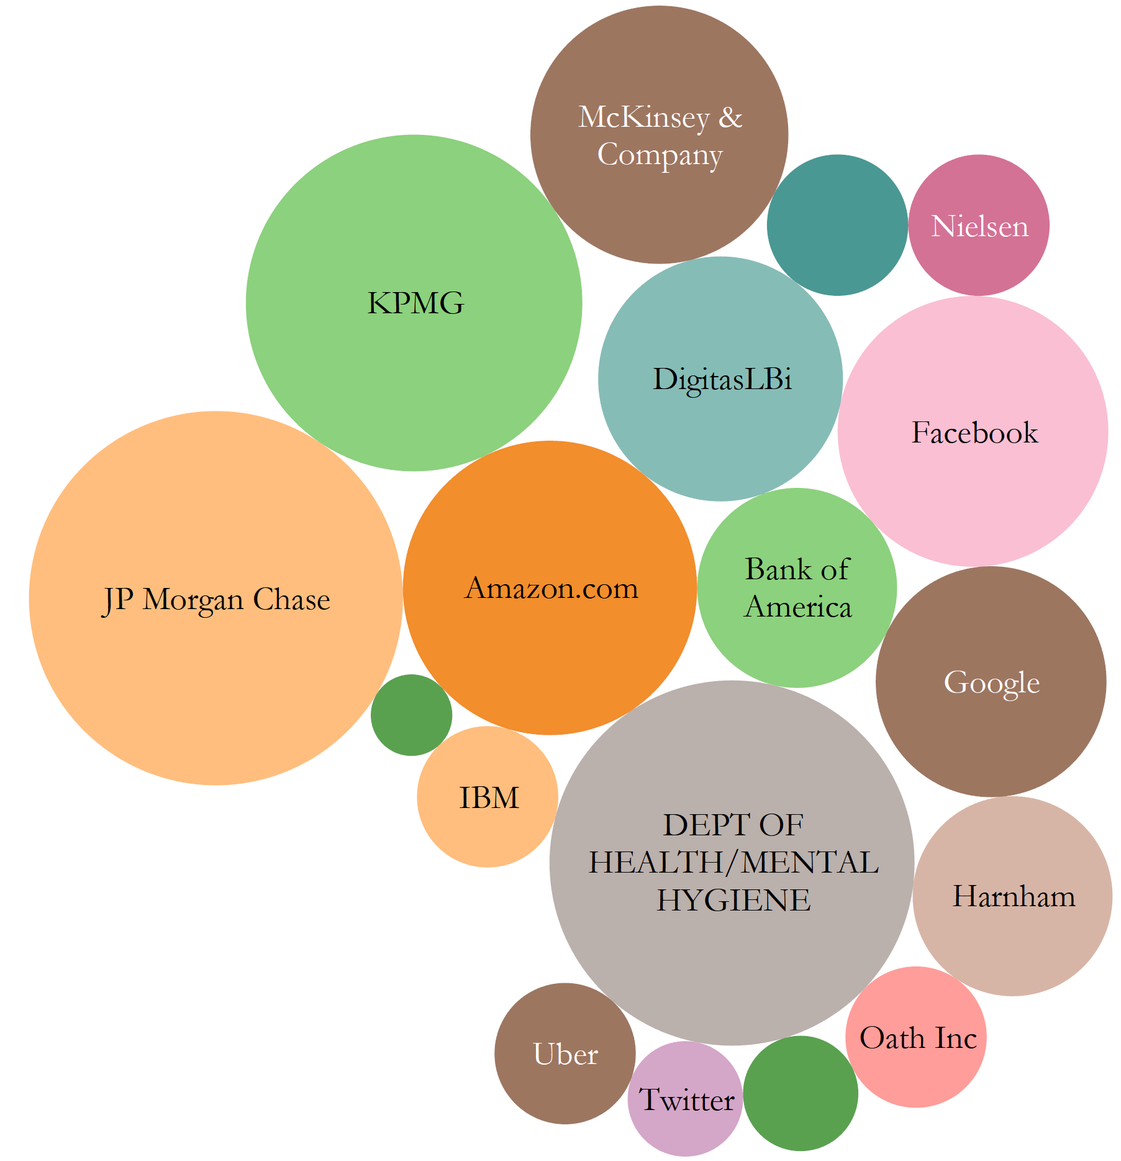
Who gets hired?
An outlook of the Data Scientist Job Market in the U.S.
NYC Data Science Academy #14
Shanshan “Silvia” Lu

Slide 2
Scraping Process and Problems
Data Source: https://www.indeed.com/
Scraped Information: Position, Company, Location, Job Description, and Number of Company Reviews.
In total, 6876 jobs have been scraped on Aug. 3rd.
Exploring questions:
What type of talents do employers want concerning tools, skills, degrees, and majors?
Do employers know the difference between data engineer, data scientist and data analyst? Does the job description match the position?
Indeed limits the pages to 100 at most.
Recurrent sponsored jobs.

Slide 3
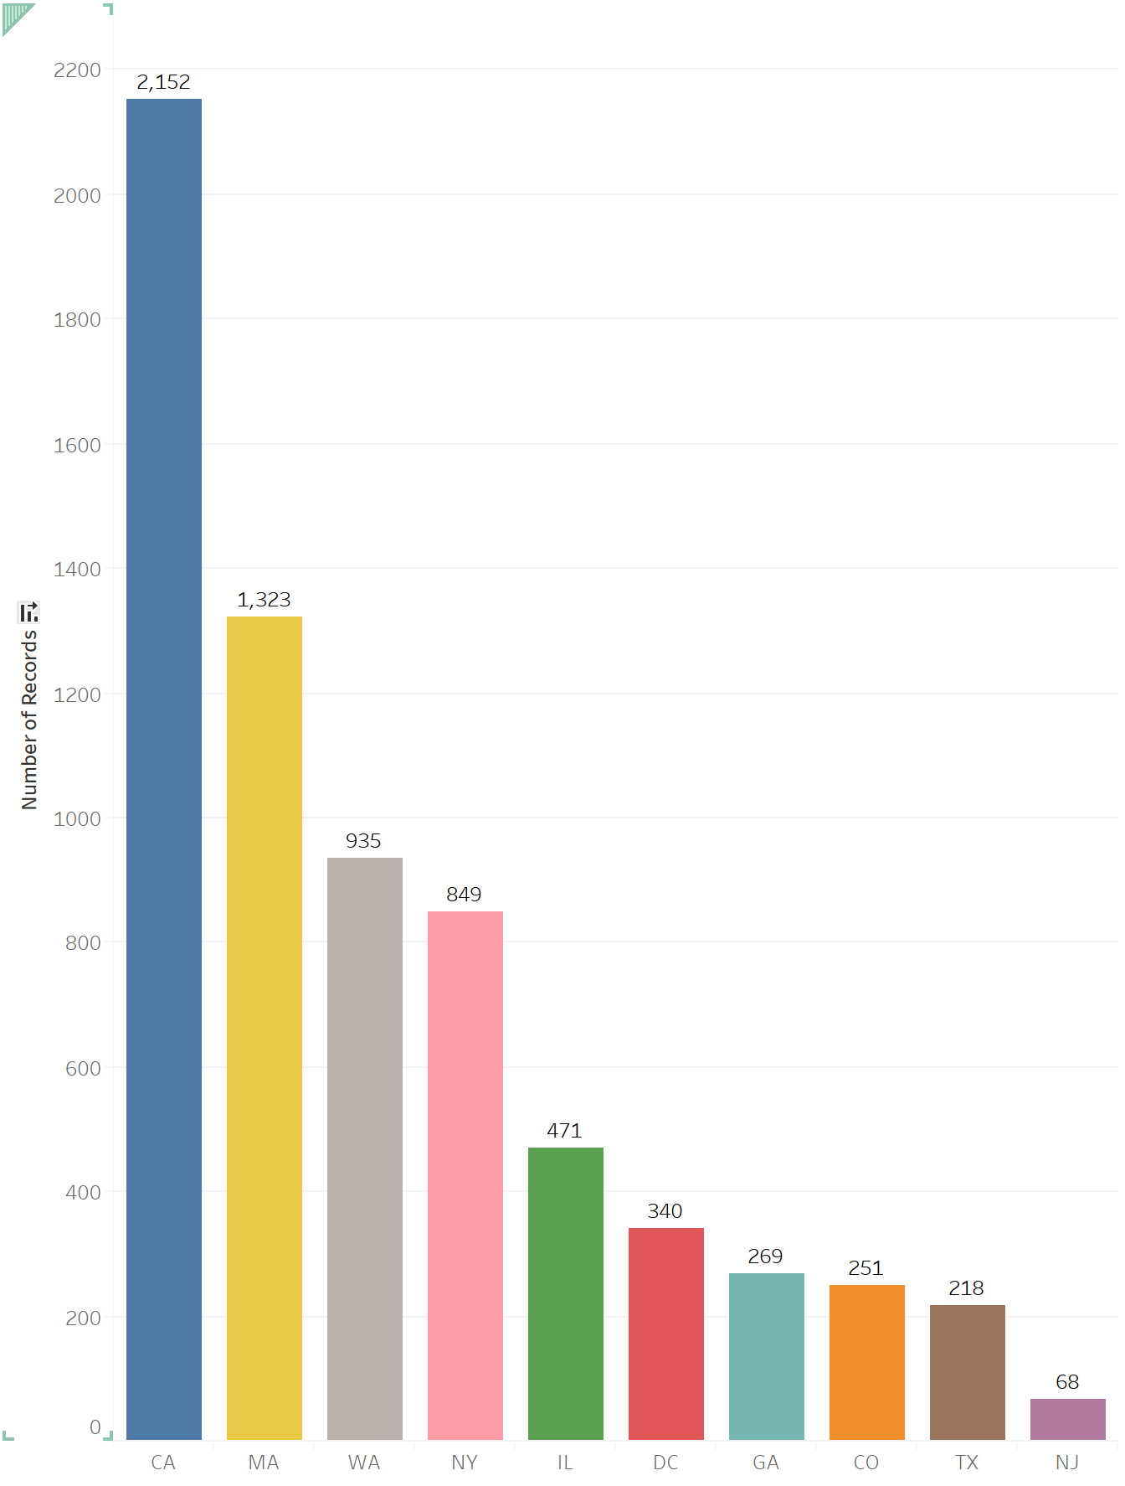
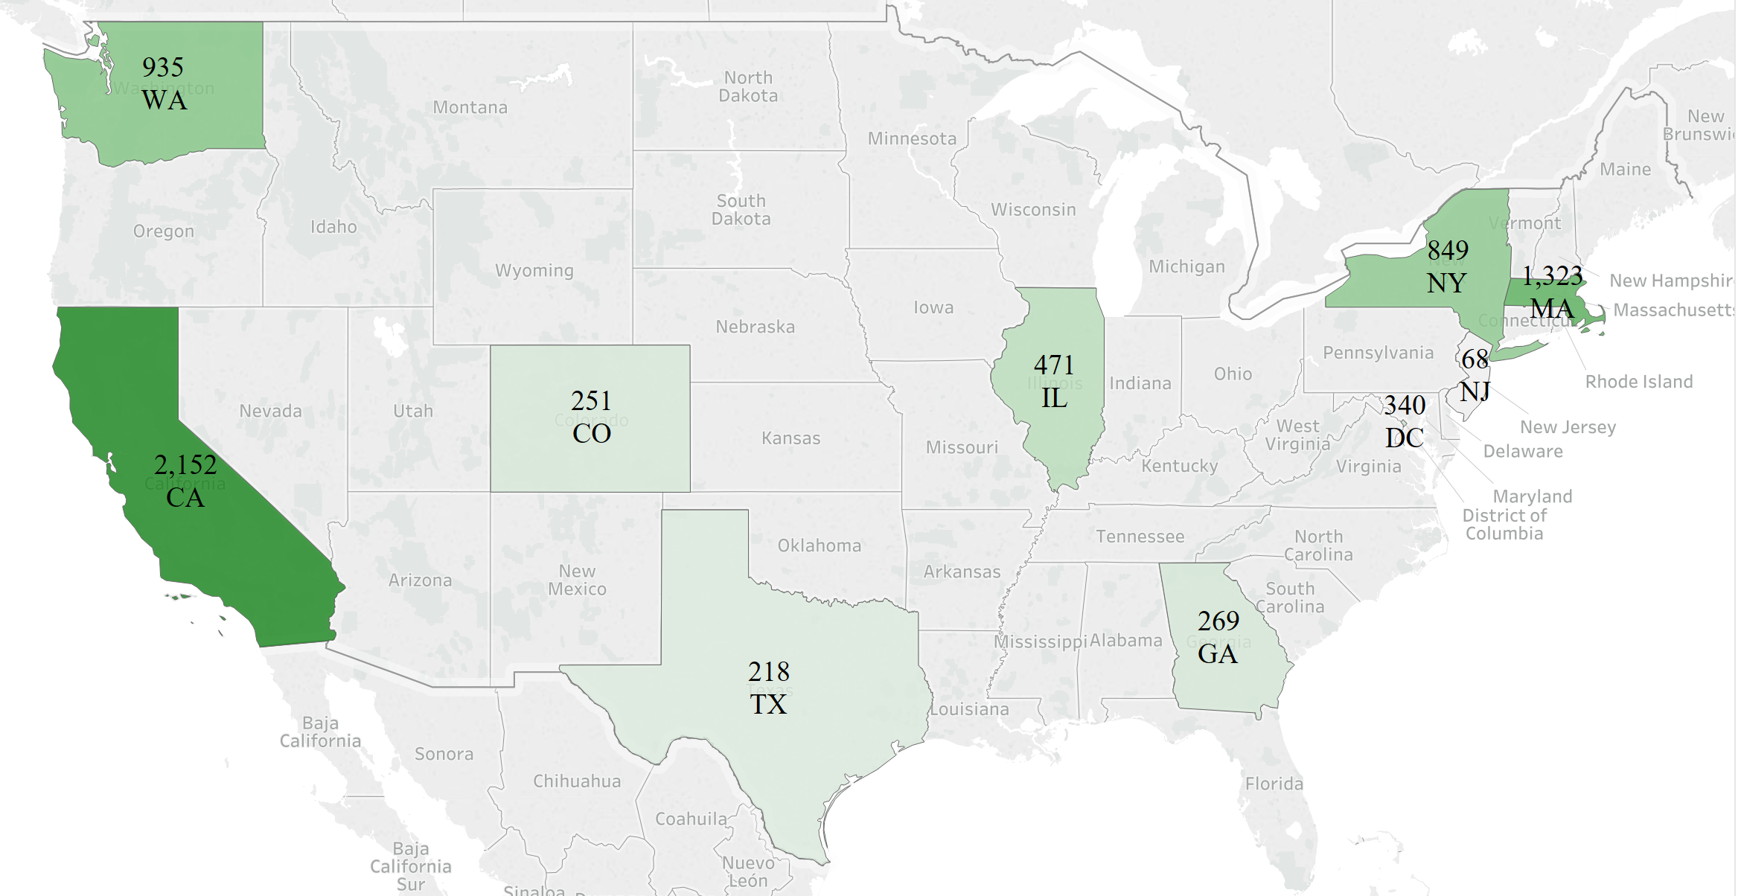
Number of Data Scientist Job in 2018

Slide 4
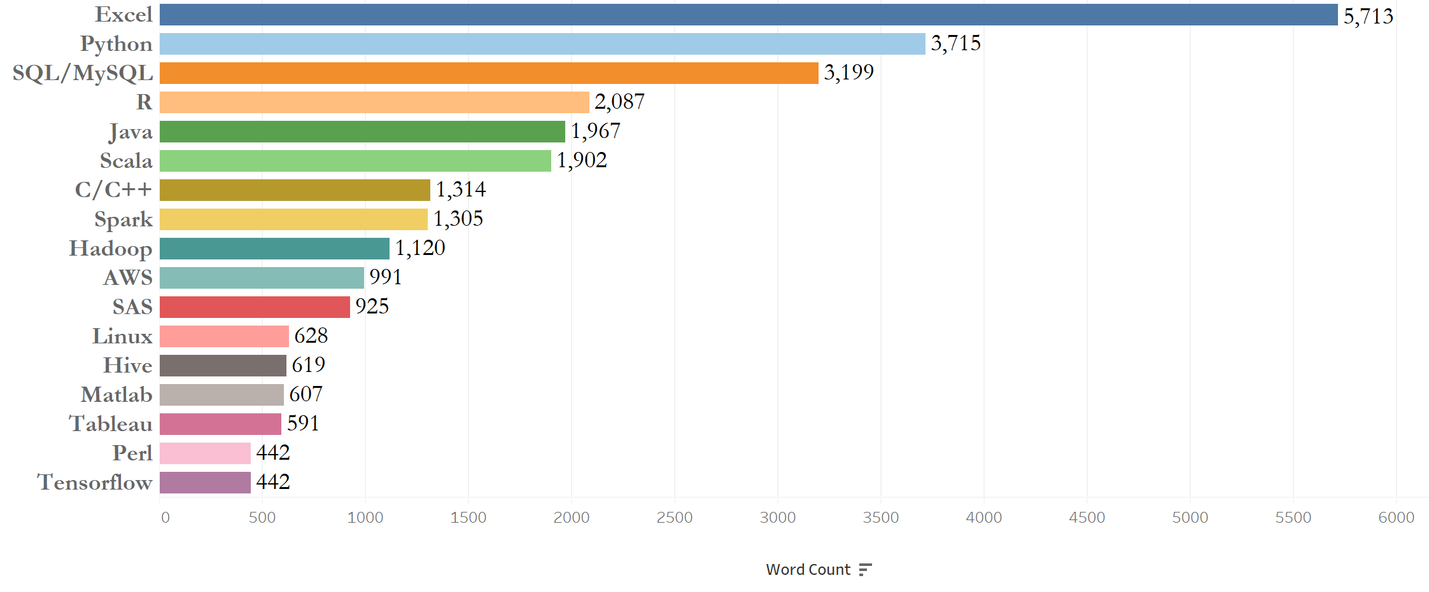
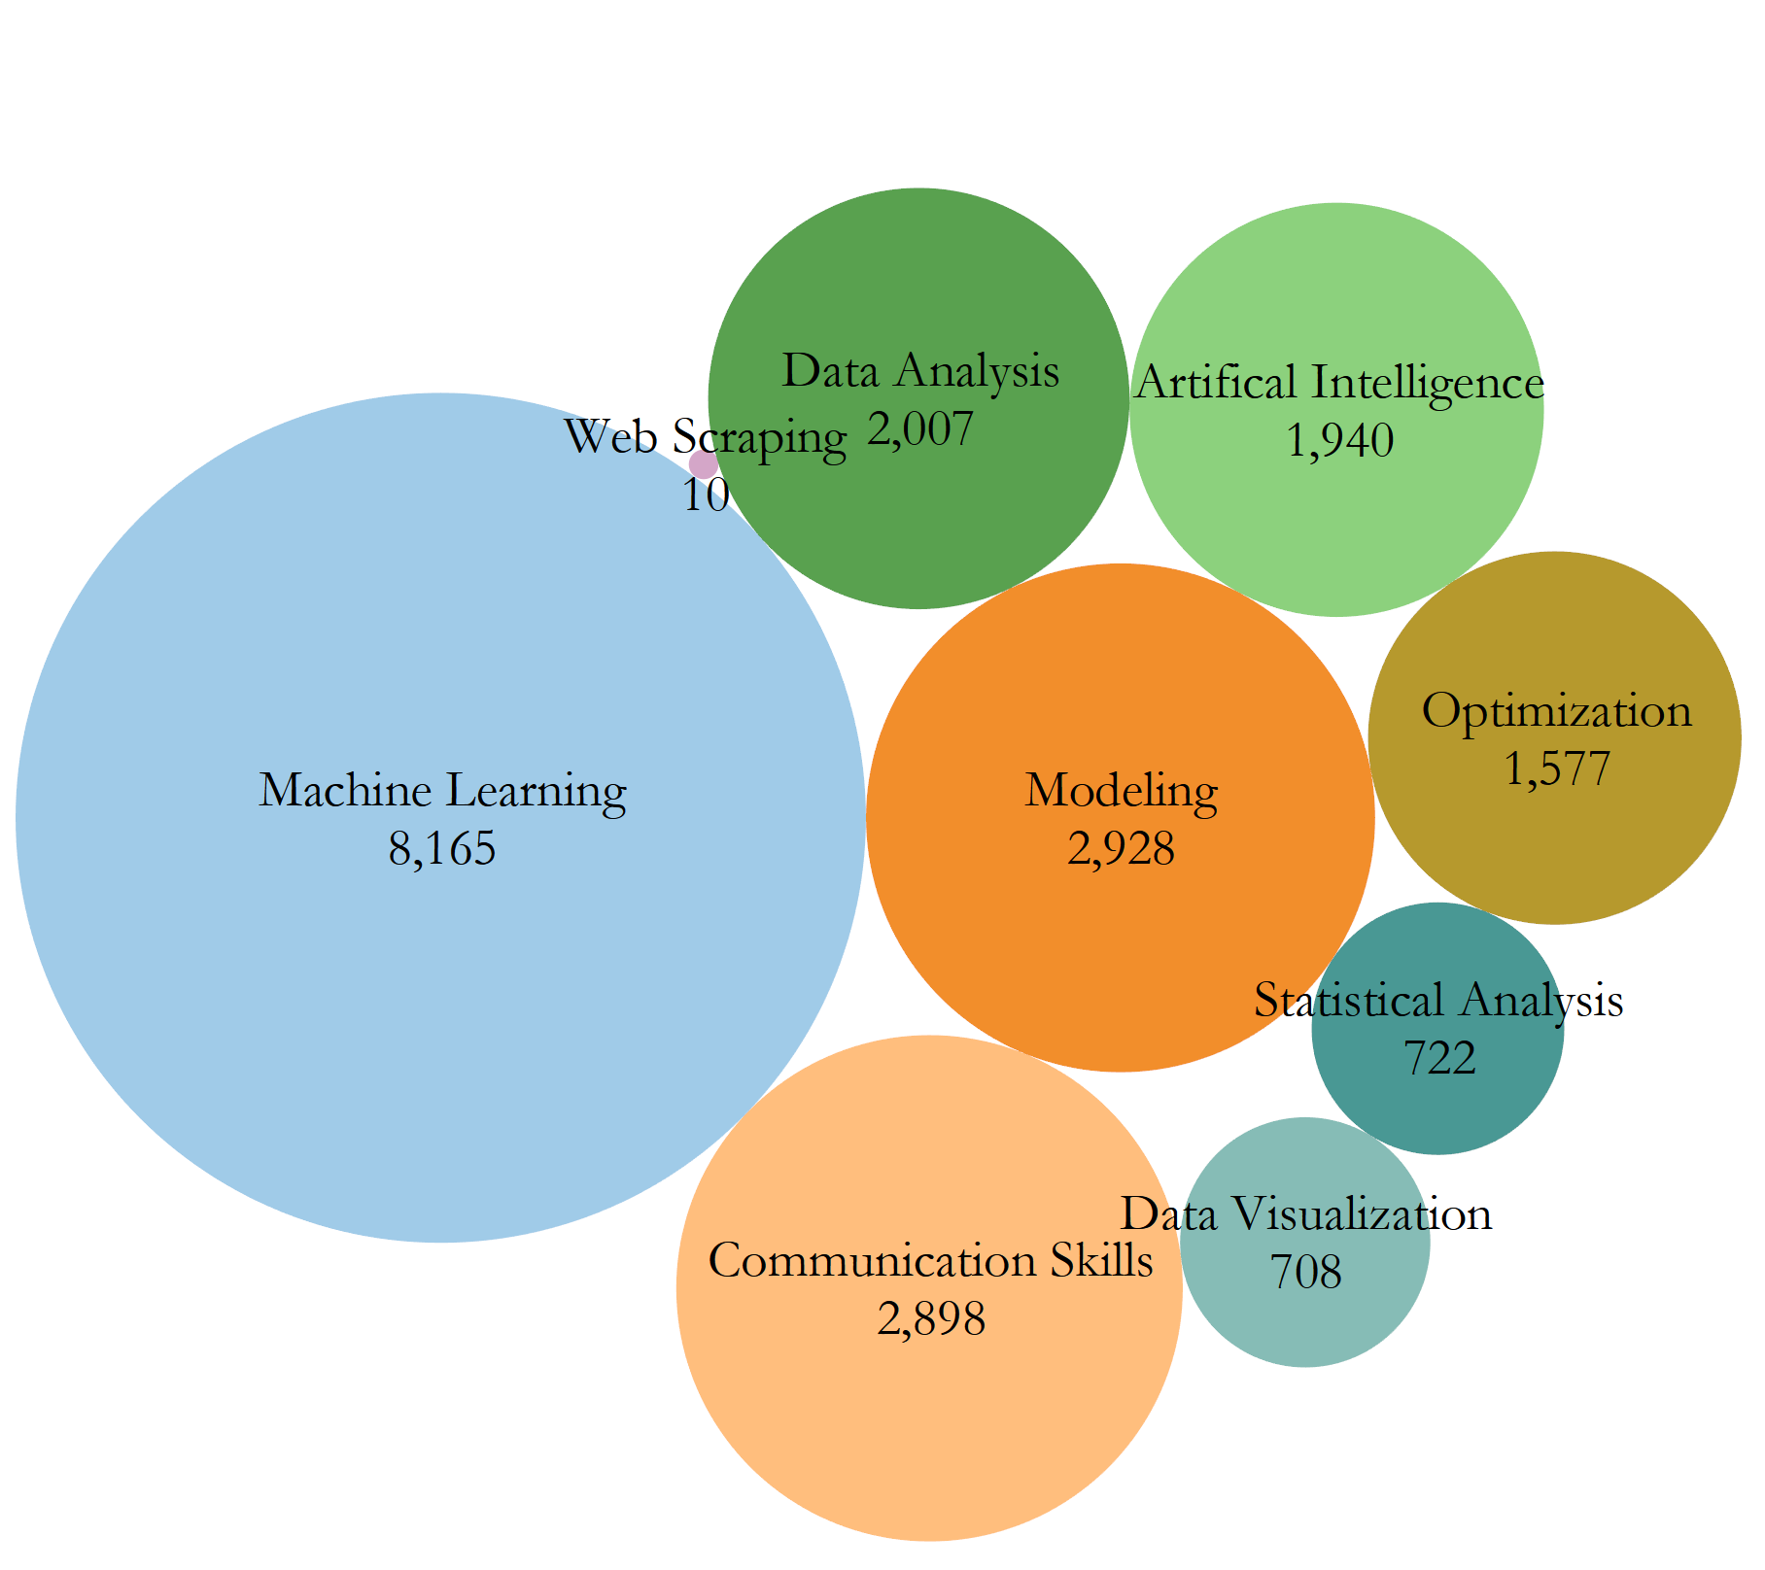
What tools and skills are desired the most?

Slide 5
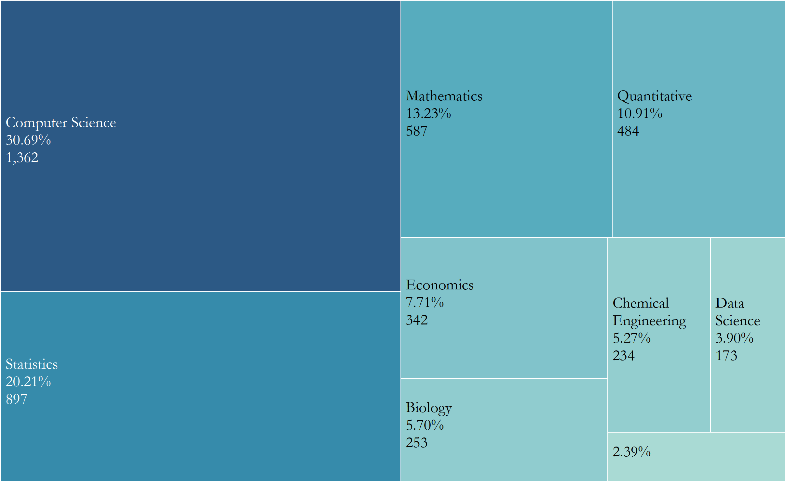
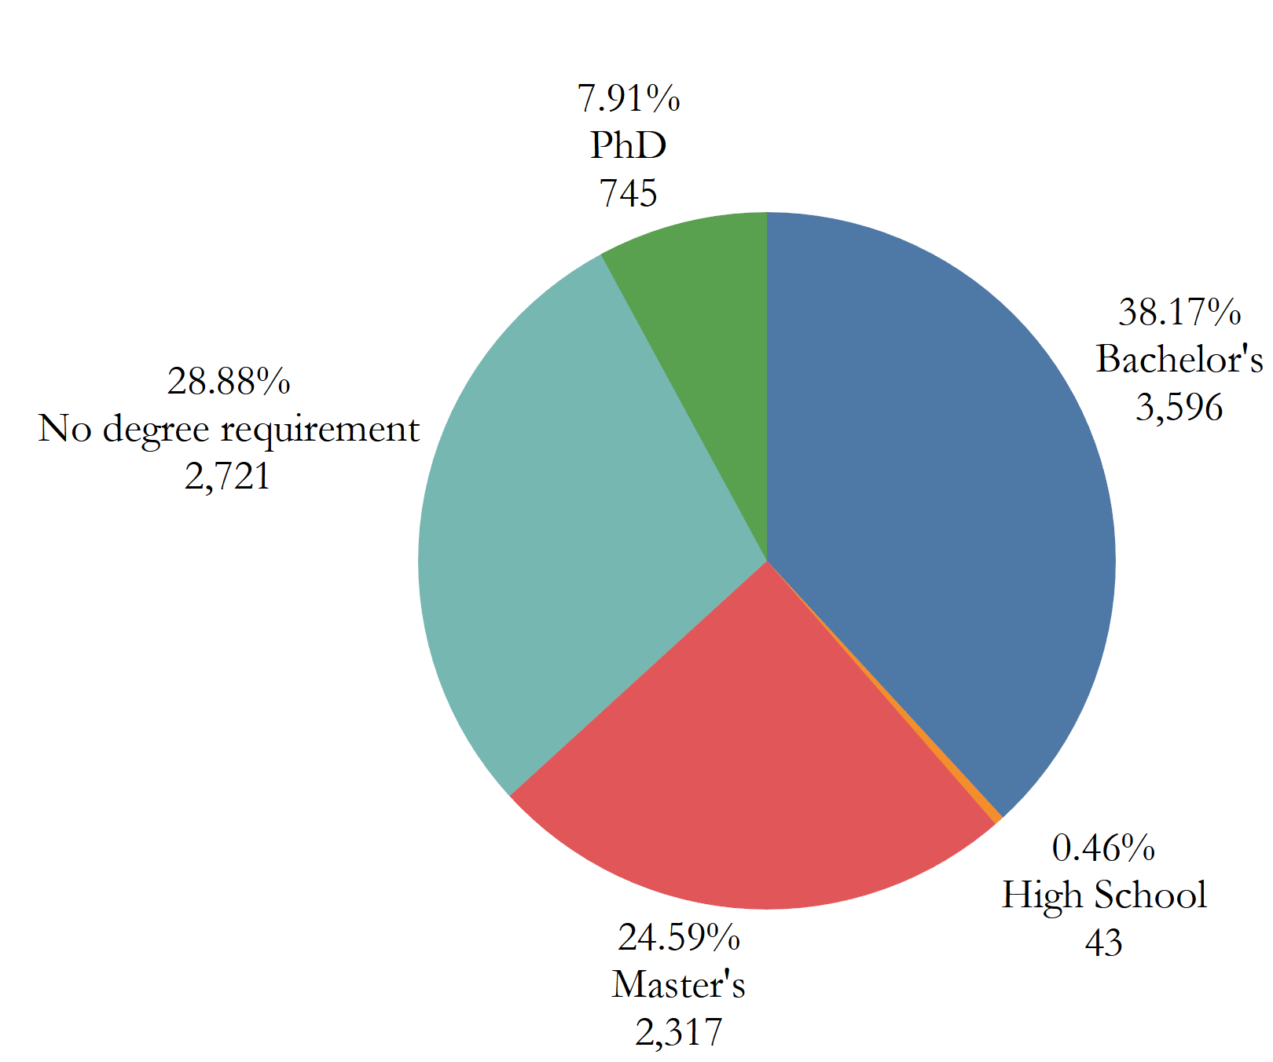
Does the degree matter?

Slide 6
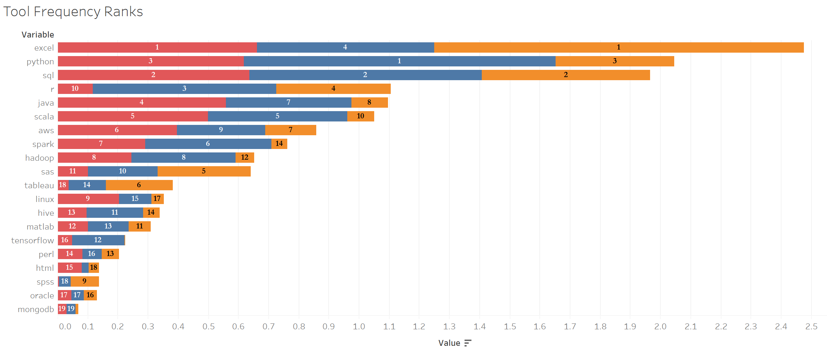
Engineer vs. Data Scientist vs. Analyst

Slide 7
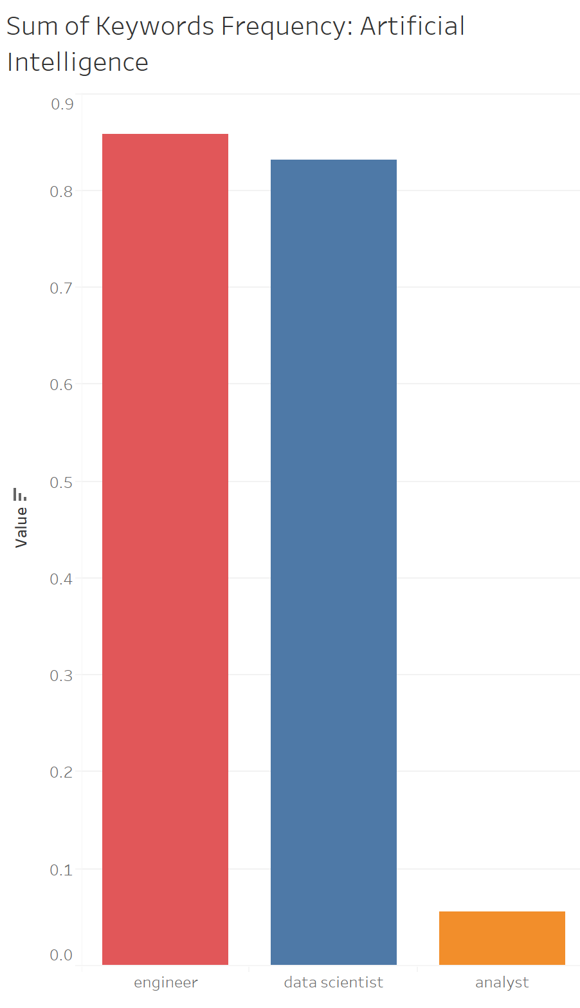
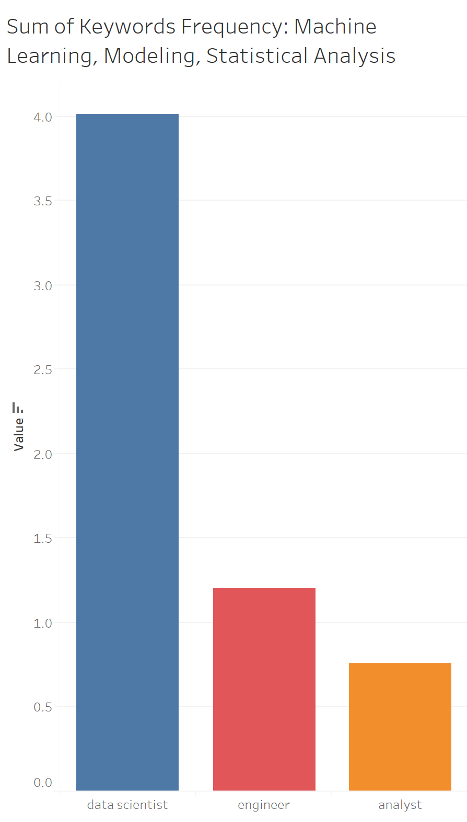
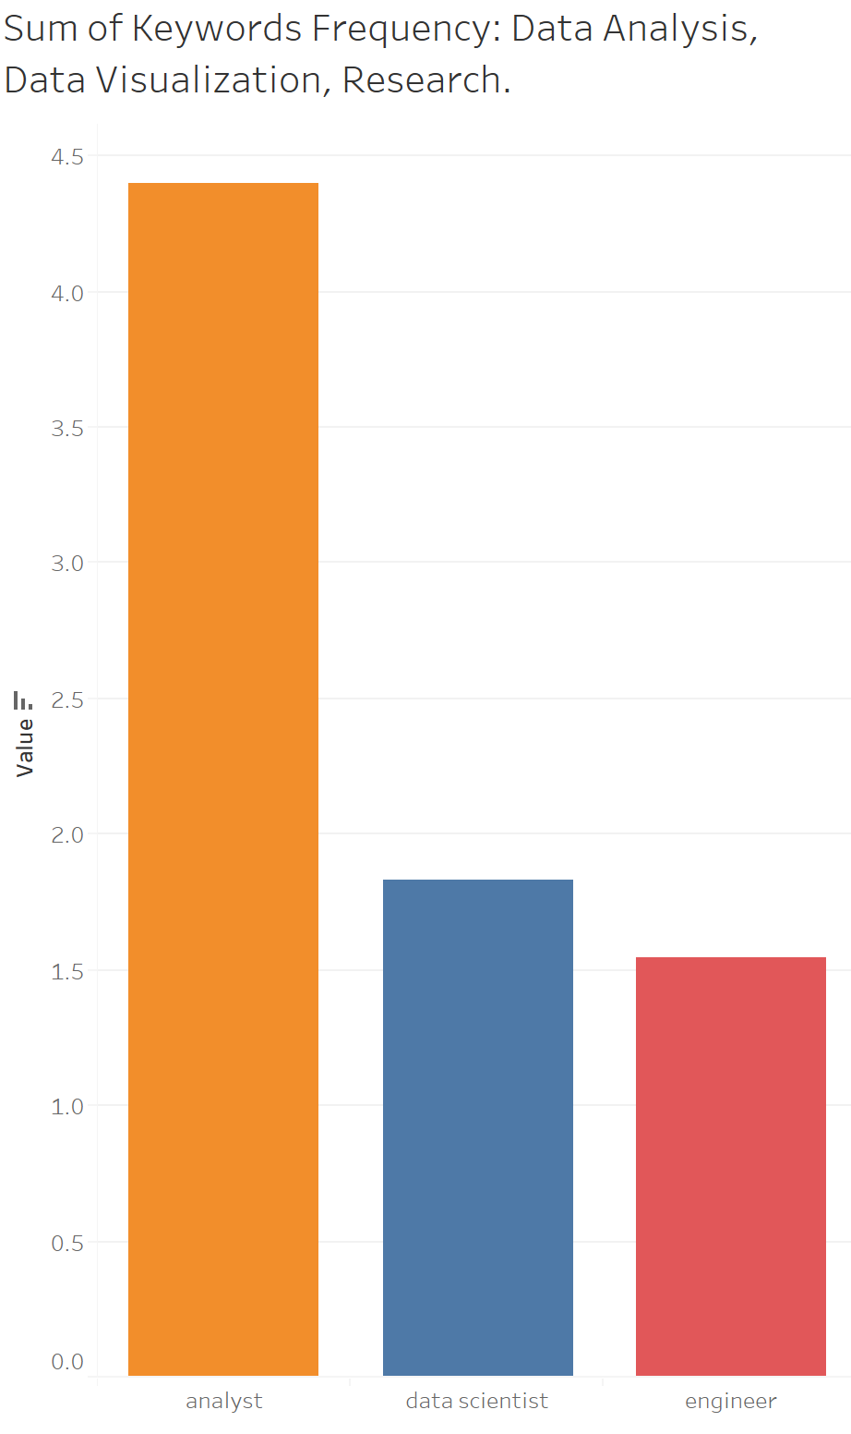
Engineer vs. Data Scientist vs. Analyst

Slide 8
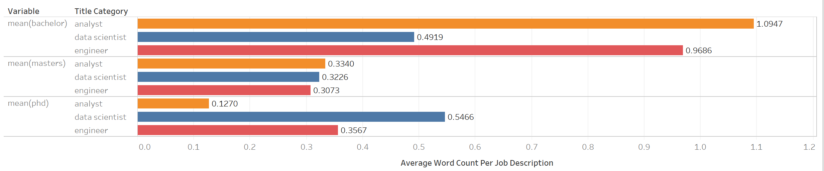
Engineer vs. Data Scientist vs. Analyst

Slide 9
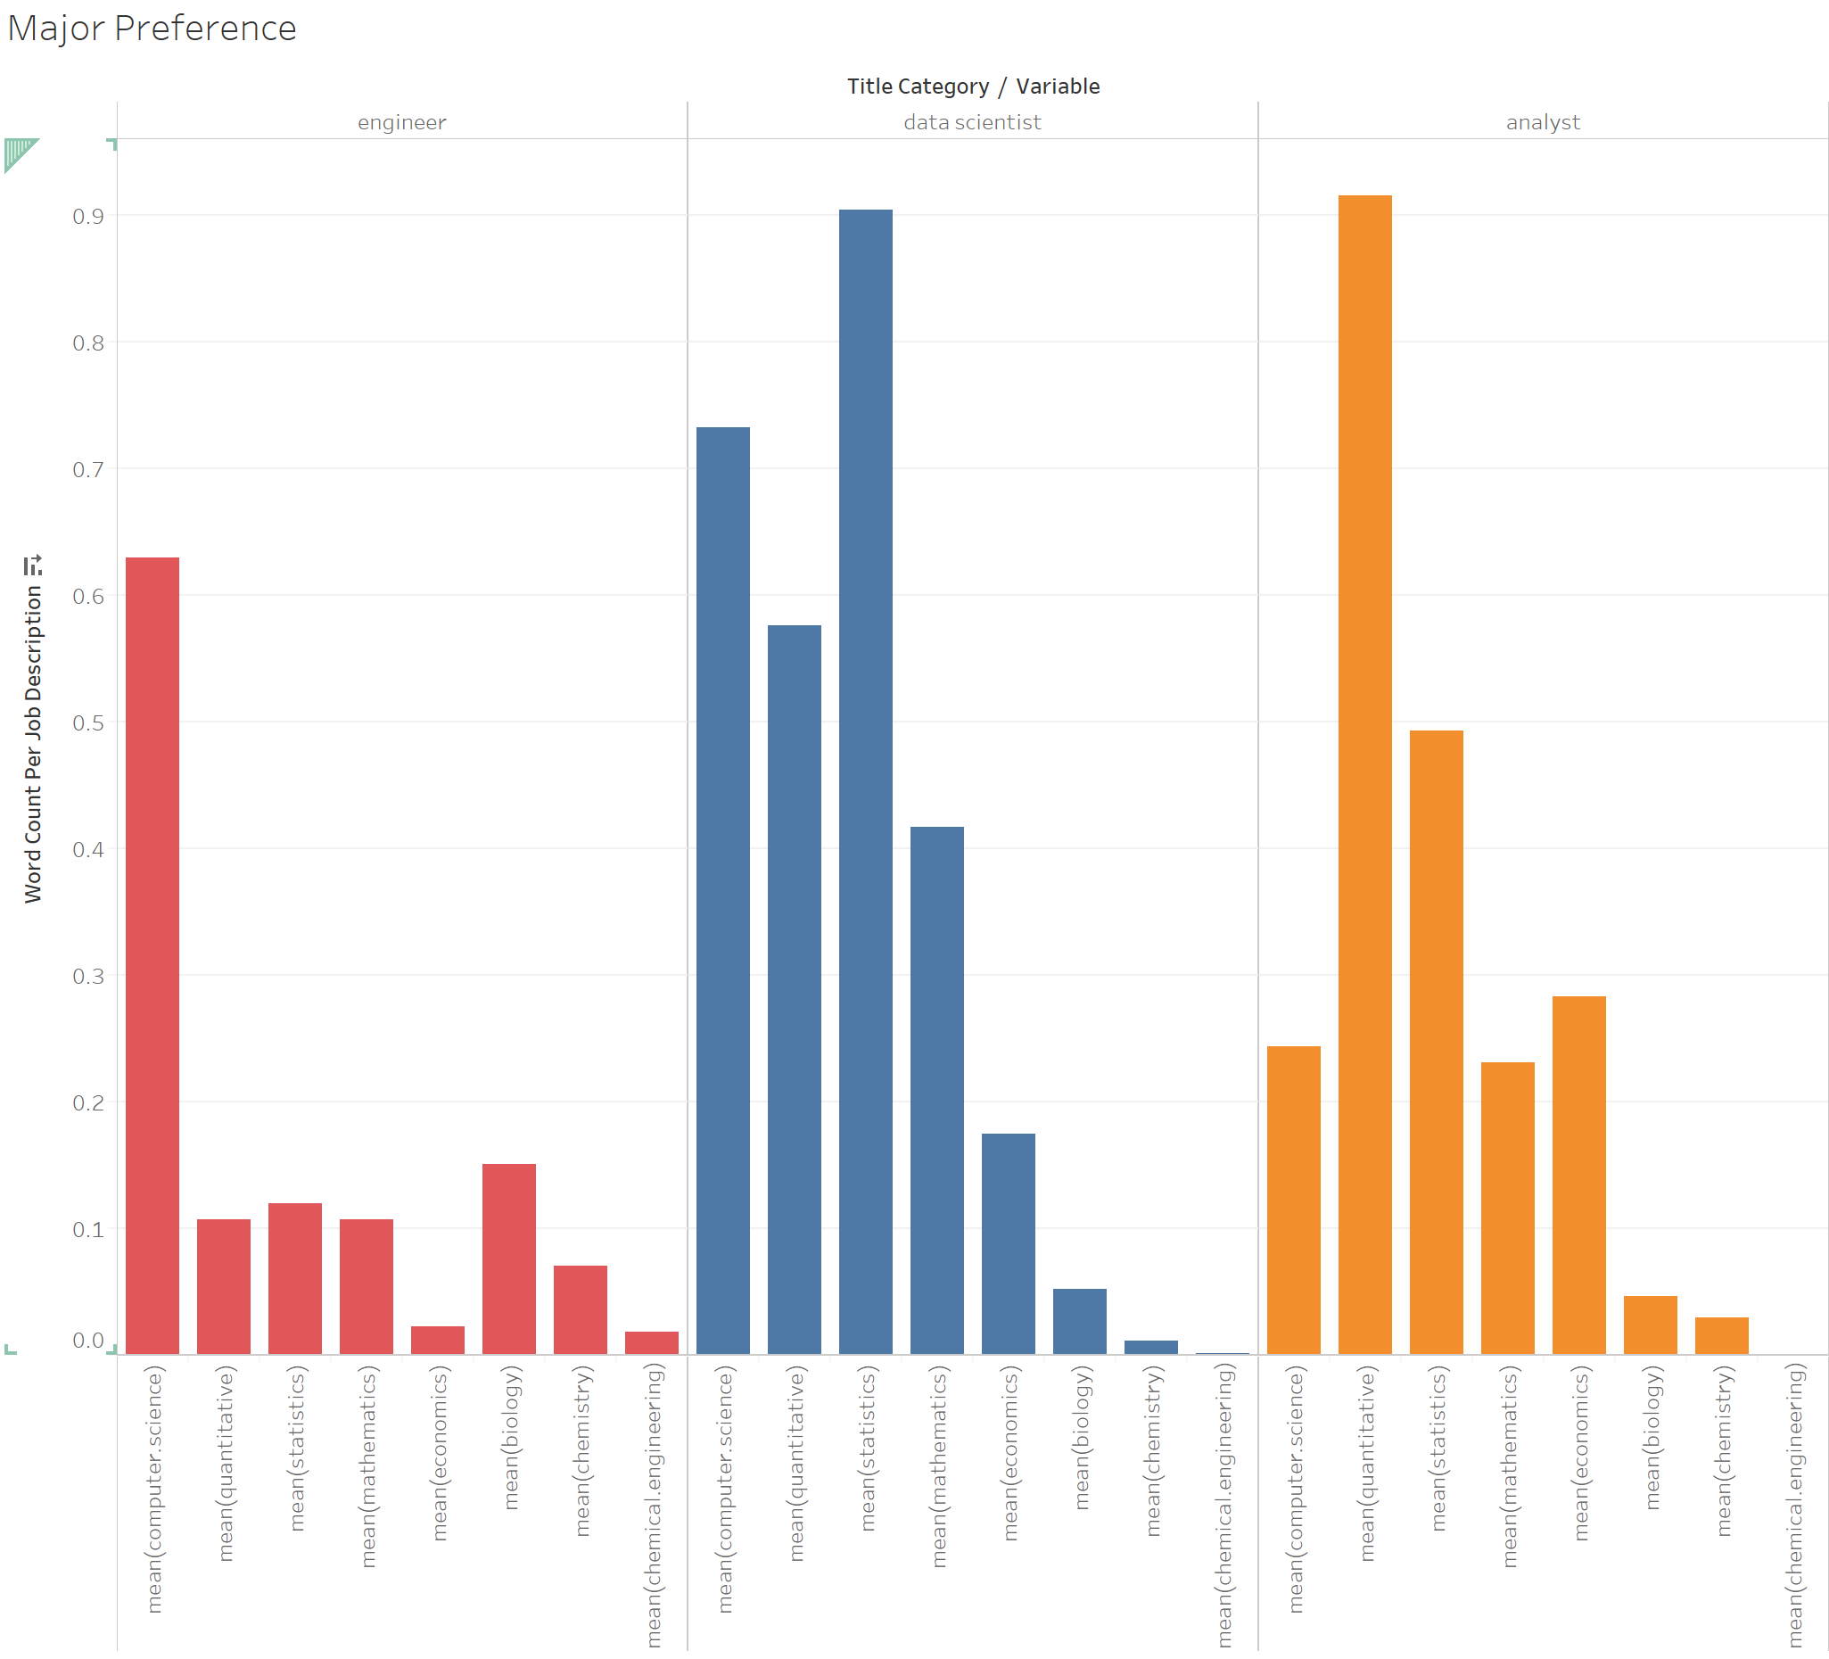
Engineer vs. Data Scientist vs. Analyst
Majors

Slide 10
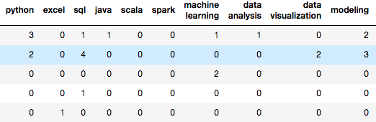

Can we use word frequencies to classify job types?
Problem:
All variables are picked manually.
Too many variables for an unsupervised machine learning clustering.
Results:
Possible Reasons:
Predictors were chosen badly.
Employers don’t know what type of people they want.

Slide 11
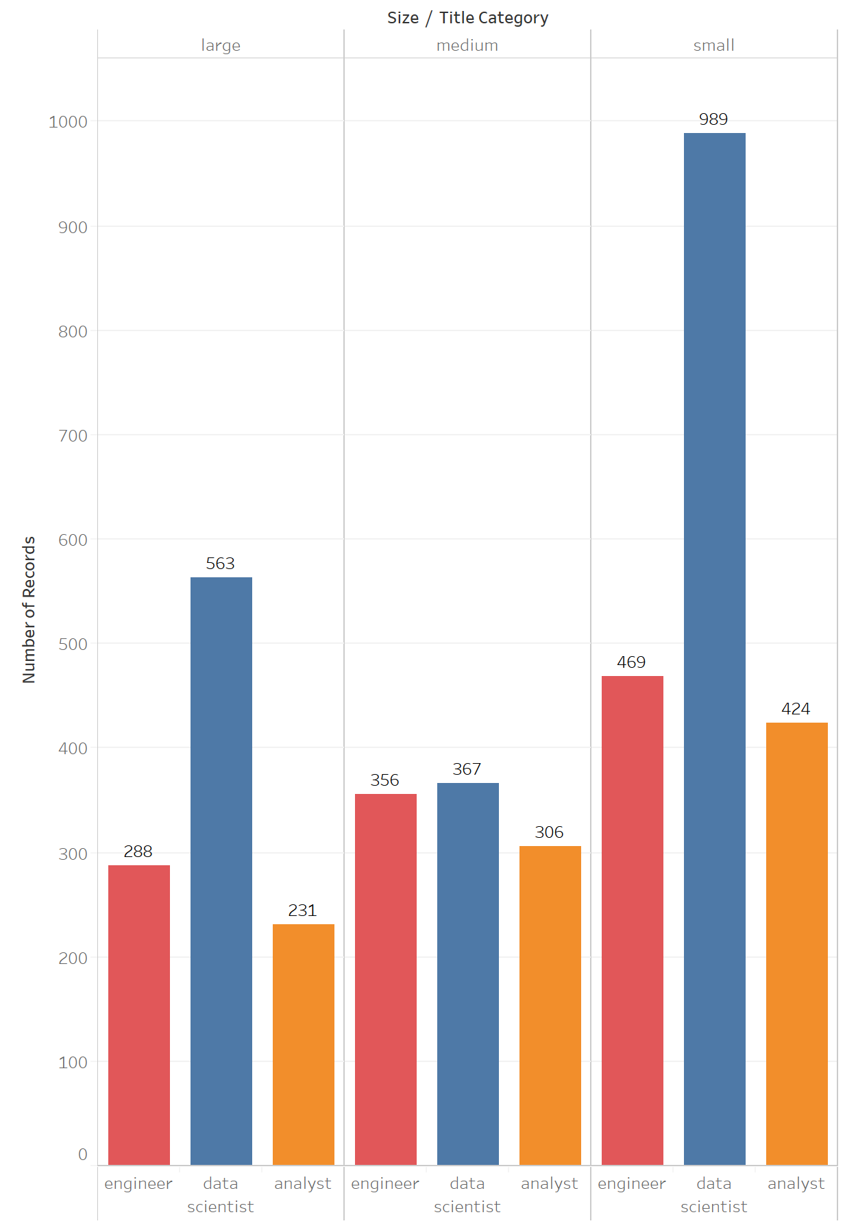
Small companies hiring the most data scientists?

Slide 12
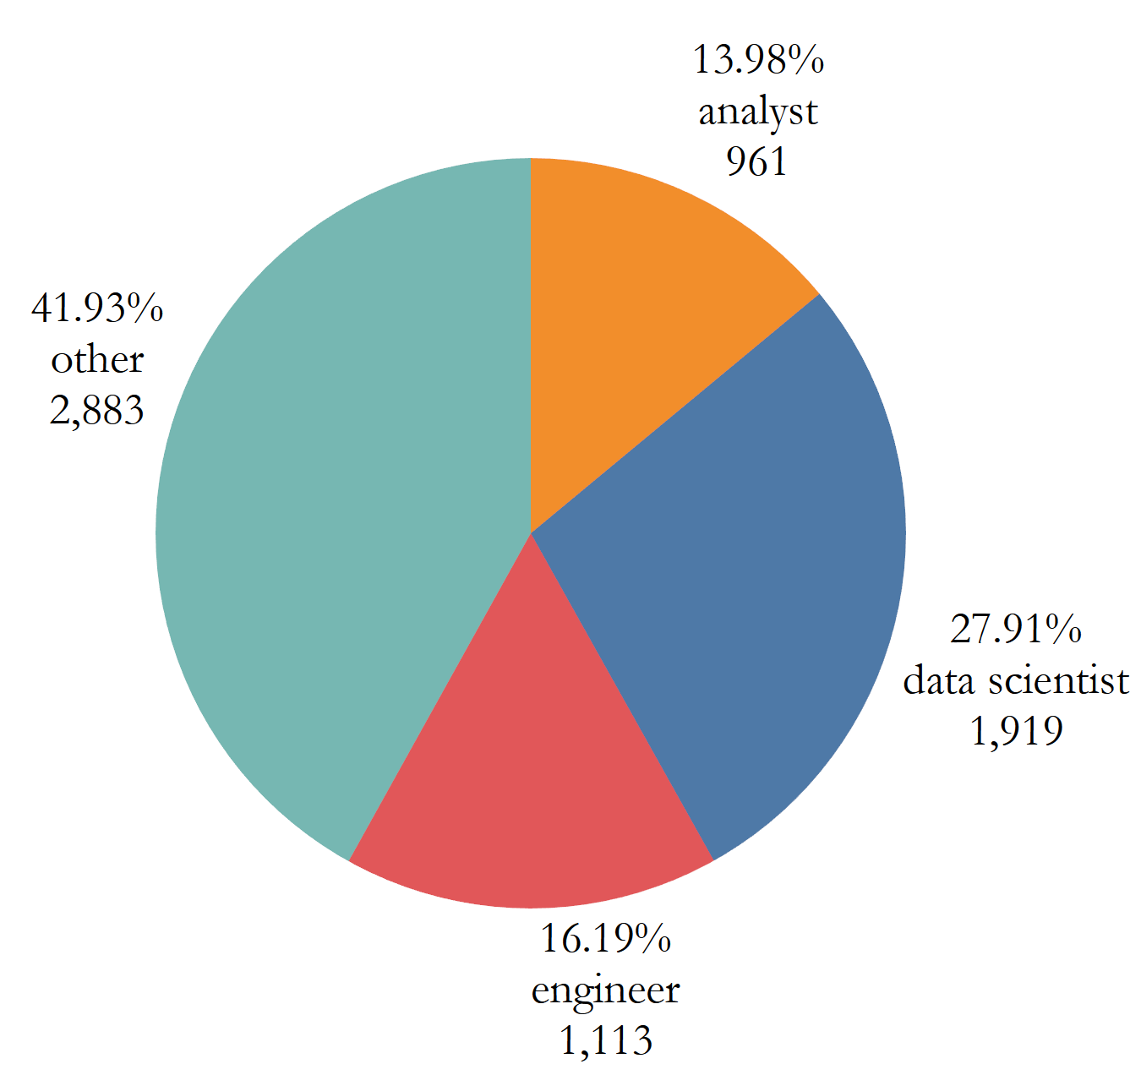
Limitations
Customized job postings by indeed may bias the data.
Limited sample size.
Unverified title categorization.
Overcounting several words: “engineer”, “data science”, etc.

Slide 13
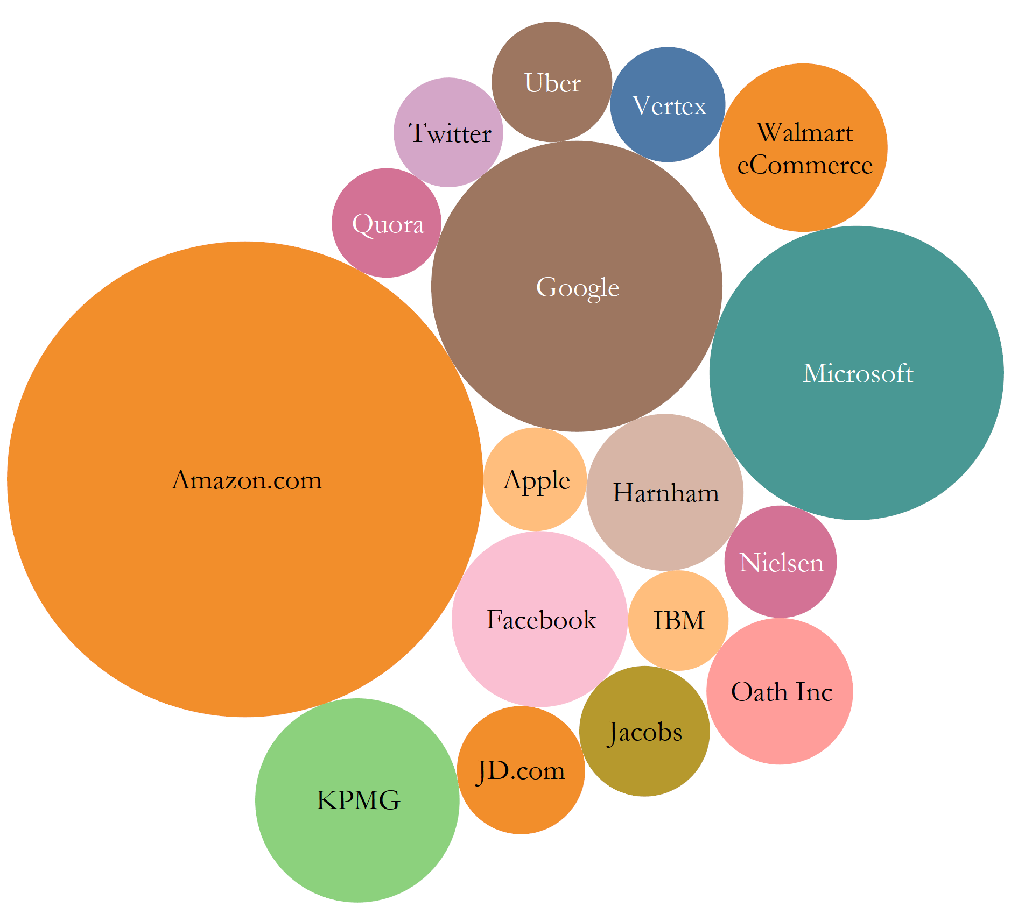
Conclusions
Who gets hired:
Excel, Python, R, SQL,
Machine Learning, Data/Statistical Analysis, Data Visualization.
Master’s degree (or higher) in Statistics, Mathematics, Computer Science, Data science, Engineer or Quantitative field.
(Resume tips)
Do employers know who they want to hire?
Not really : (
Read job descriptions carefully.

